Slide 1

Exploratory Data Analysis
G2M insight for Cab Investment firm
21 November 2024
By: Rohan Khatri, LISUM39

Slide 2

Agenda
Executive Summary
Problem Statement
Approach
EDA
EDA Summary
Recommendations

Slide 3
Executive Summary
Assessment of the US Cab Industry for Investment Opportunities XYZ
Objective: Analyze the data metrics of two cab companies to help XYZ firm identify the right company to invest in.
Key Takeaways:
Yellow Cab makes more total profit and profit on average than Pink Cab, demonstrating stronger performance.
City-level demand varies and does not correlate with population density
There is a period of seasonality during winter times

Slide 4
Problem Statement
Context:
XYZ is a private firm in US. Due to remarkable growth in the Cab Industry in last few years and multiple key players in the market, it is planning for an investment in Cab industry and as per their Go-to-Market(G2M) strategy they want to understand the market before taking final decision.
Data Overview:
Cab_Data.csv: Transaction details for the two companies from 31/01/2016 to 31/12/2018.
Customer_ID.csv: This is a mapping table that contains a unique identifier which links the customer’s demographic details.
Transaction_ID.csv: This is a mapping table that contains transaction to customer mapping and payment mode.
City.csv: This contains the list of U.S. cities, their population, and number of cab users.
Challenges:
Datasets require cleaning to split and combine to diversify.
Examine trends in profitability, customer demands and demographics.

Slide 5
Approach
Content:
Data Preparation: Processed datasets by cleaning, transforming, adding relevant categories, and finally merging into one cumulative dataset (Cab_Data, Customer_ID, Transaction_ID, City.csv).
Exploratory Data Analysis (EDA): Analyzed patterns in profitability, customer demographics, and city-level usage.
Hypothesis Tests: Tested and validated/disproved theories regarding ride frequency, cab preference, and profitability.
Analyze Results: Assessed Yellow Cab vs Pink Cab based on performance indicators and provided recommendations accordingly.

Slide 6
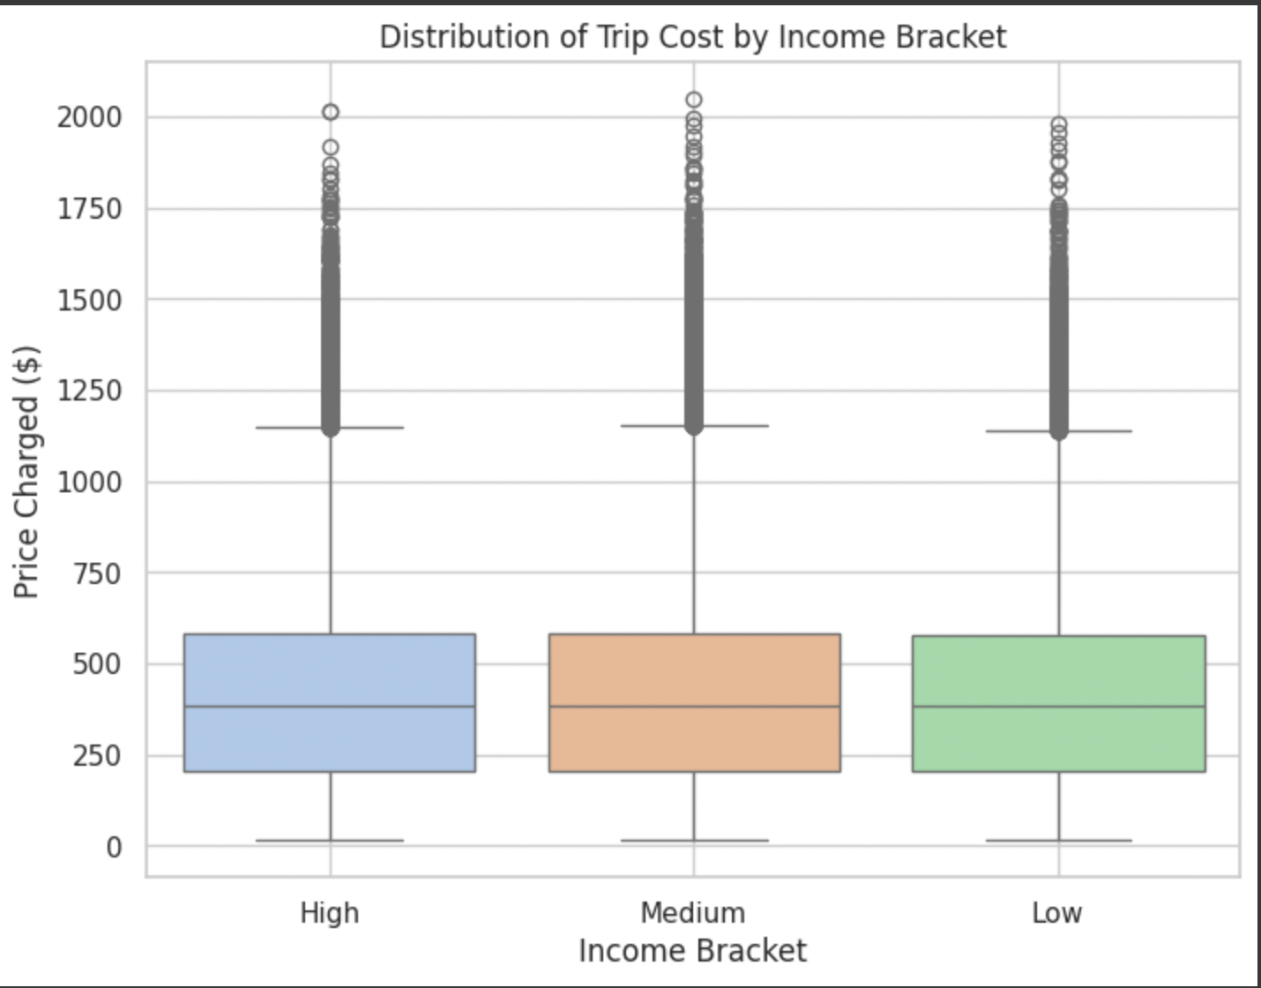
Exploratory Data Analysis (EDA)
Here, there is no significant difference in between income brackets in terms of price charged, but customers of “high” income have a slightly higher median cost.

Slide 7
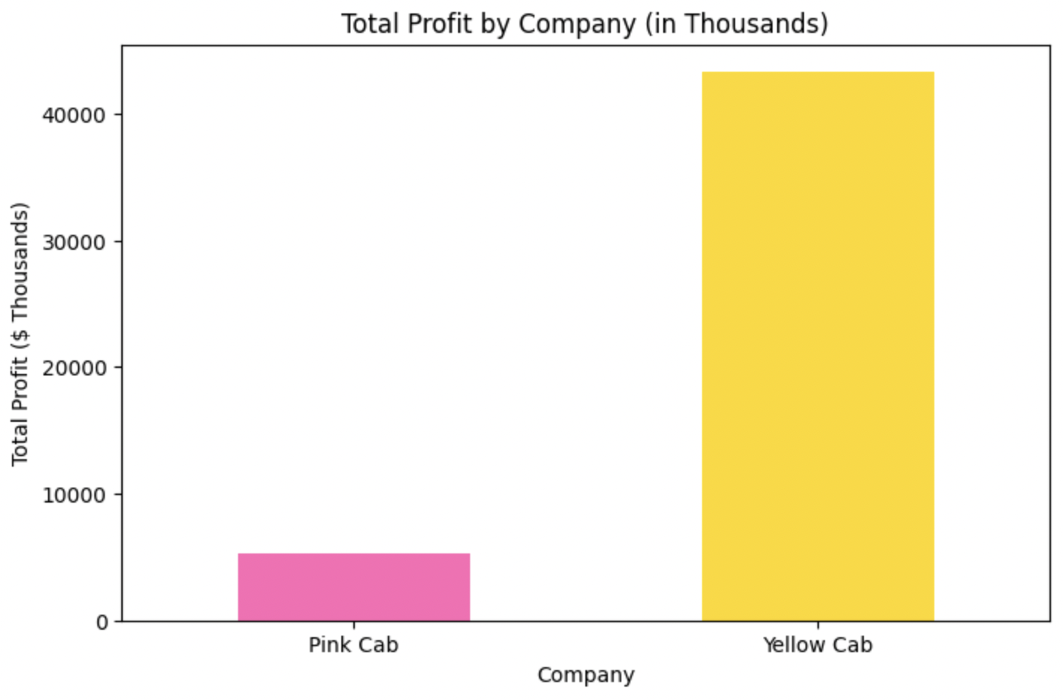
Exploratory Data Analysis (EDA)
Here, the Yellow Cab company clearly makes more total profit compared to the Pink Cab company.

Slide 8
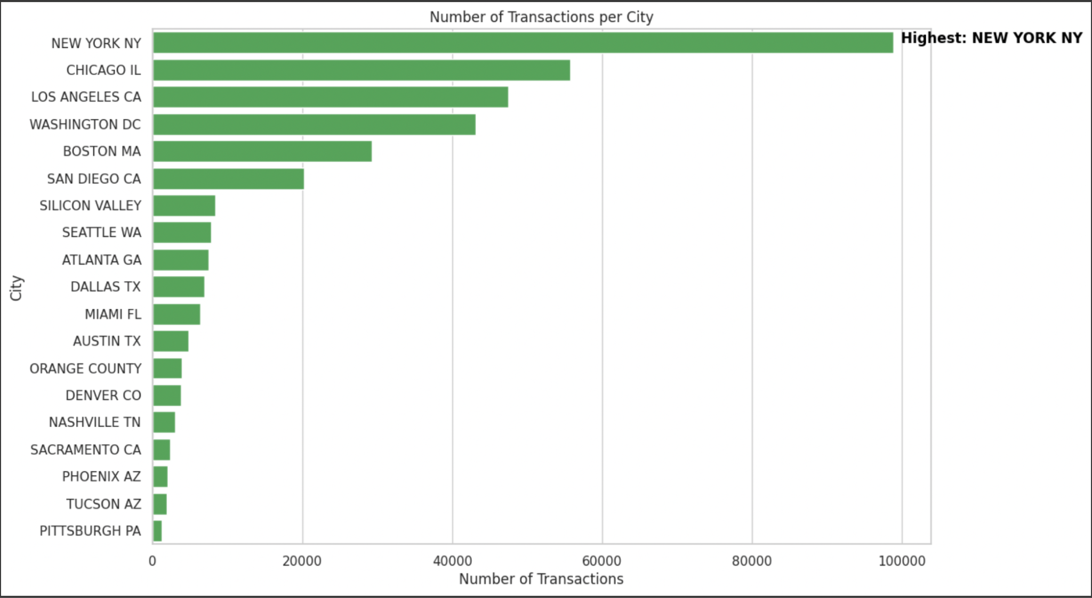
Exploratory Data Analysis (EDA)
New York, NY is the city with the highest amount of transactions.

Slide 9
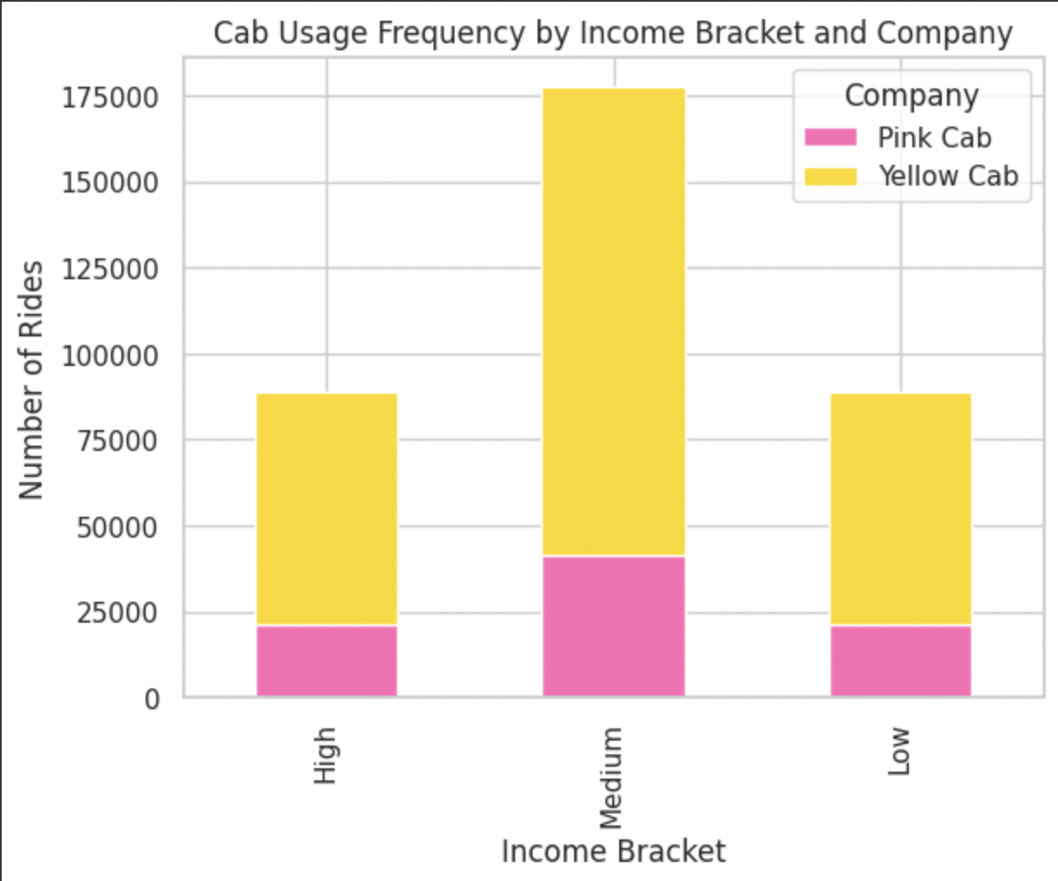
EDA Hypothesis #1
Null Hypothesis (H₀): There is no significant difference in cab service usage frequency between higher-income and lower-income customers.
Alternate Hypothesis (H₁): Higher-income customers use cab services more frequently than lower-income customers.

Slide 10
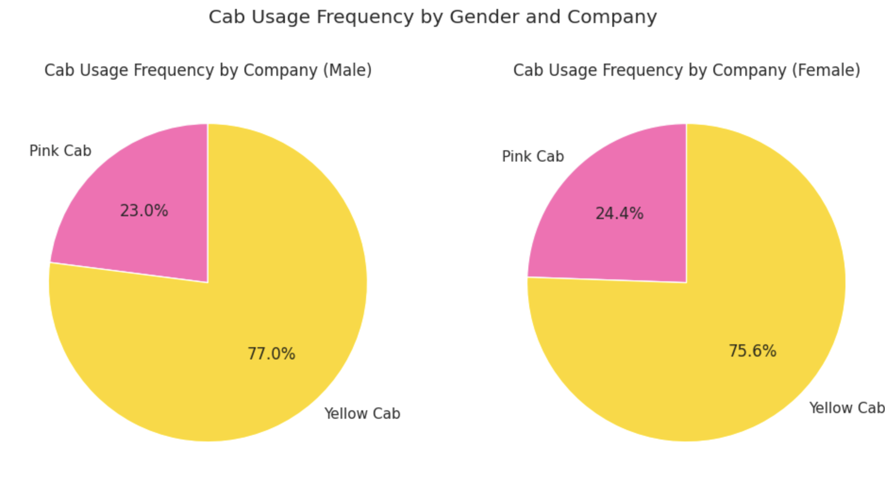
EDA Hypothesis #2
Null Hypothesis (H₀): There is no significant difference in cab service usage frequency between genders.
Alternate Hypothesis (H₁): There is significant difference in cab usage frequency between genders.

Slide 11
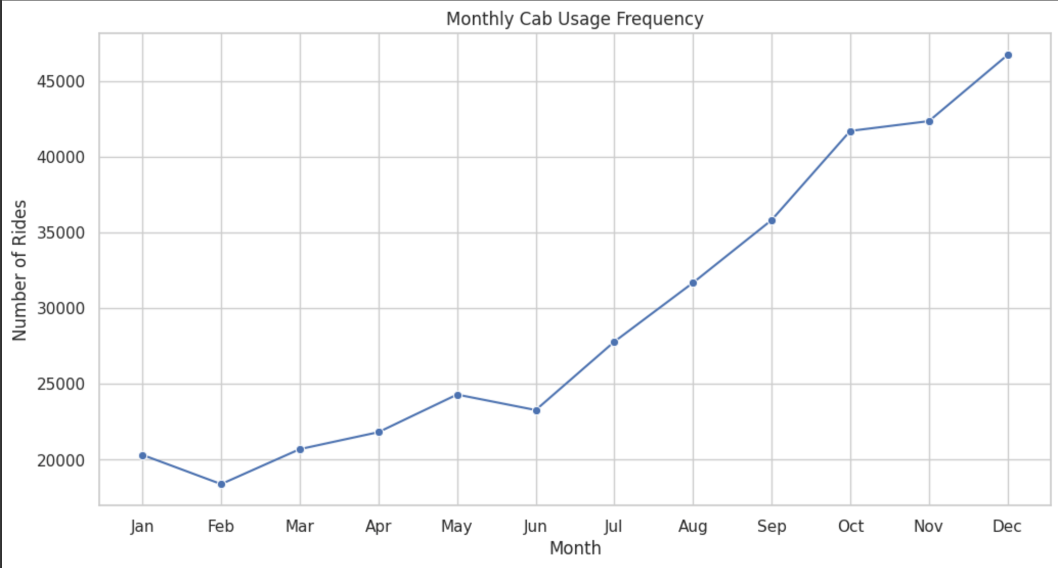
EDA Hypothesis #3
Null Hypothesis (H₀): There is no significant seasonality in the number of customers using the cab service base.
Alternate Hypothesis (H₁): There is significant seasonality in the number of customers using the cab service, with certain months or seasons seeing higher usage.

Slide 12
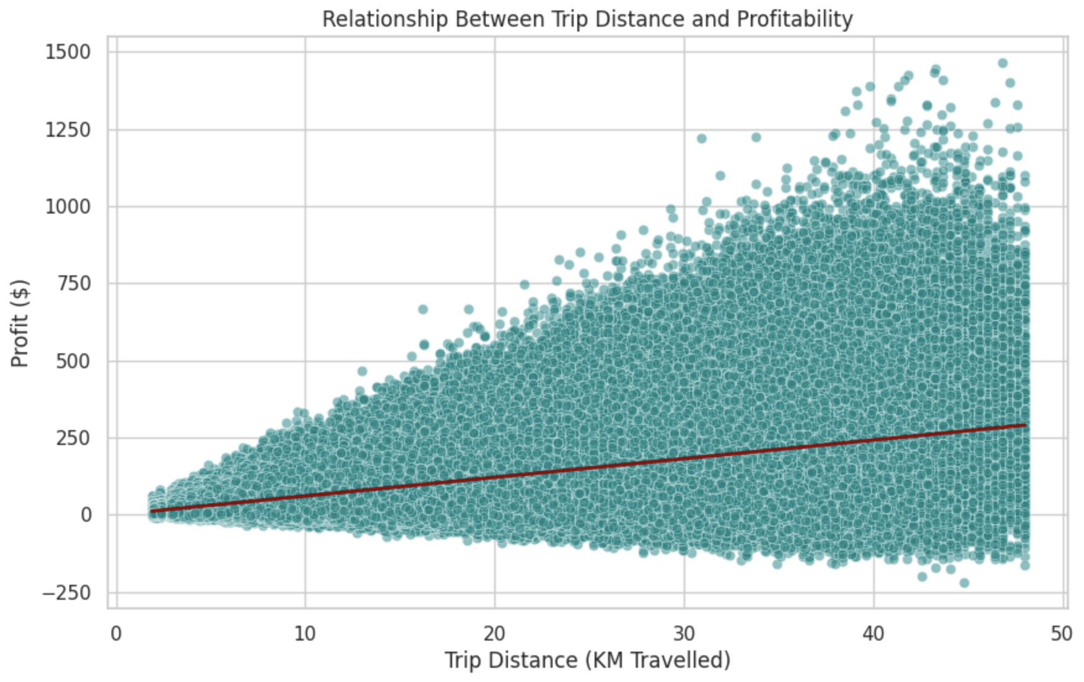
EDA Hypothesis #4
Null Hypothesis (H₀): There is no significant relationship between trip distance and profitability.
Alternate Hypothesis (H₁): Longer trips generate higher profitability per ride.

Slide 13
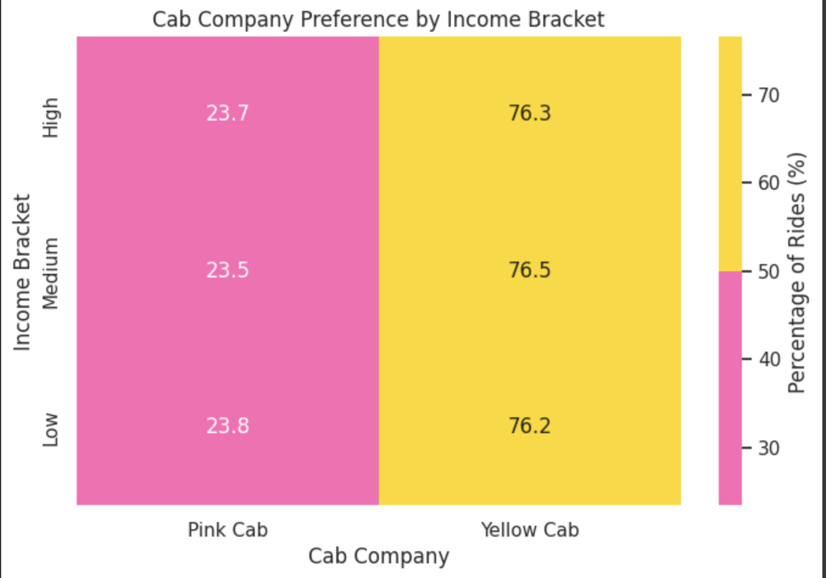
EDA Hypothesis #5
Null Hypothesis (H₀): Income level does not influence the preference for one cab company over another.
Alternate Hypothesis (H₁): Higher-income customers show a preference for one cab company over the other.

Slide 14
EDA Summary
Cab Service Usage Frequency by Income Level The null hypothesis is rejected as the data supports the alternate hypothesis, showing that higher-income customers use cab services more frequently than lower-income customers.
Cab Usage Frequency by Gender
Male Customers: 77.1% of rides were with Yellow Cab, and 22.9% with Pink Cab.
Female Customers: 75.6% of rides were with Yellow Cab, and 24.4% with Pink Cab. The null hypothesis is supported as the data does not show a significant difference in cab usage frequency between genders.
Seasonal Variation The null hypothesis is rejected as the data indicates seasonal variation. There is a clear trend with a gradual increase in usage from mid-year (June/July) to the end of the year.
Relationship Between Trip Distance and Profitability The null hypothesis is rejected as the scatter plot and trend line show a positive relationship between trip distance and profitability. As trip distance increases, profit tends to increase, although there is considerable variability, especially for longer trips.
Income Level and Cab Preference The data supports the null hypothesis, indicating that income level does not significantly influence the preference for one cab company over another. The percentages for each cab company remain relatively stable across all income brackets.

Slide 15
Recommendations
Target all income segments equally by investing in attracting customers across all income brackets, as cab usage is not strongly influenced by income level.
Increase driver availability during peak months to meet high demand and enhance customer satisfaction. Launch seasonal promotions during peak times, such as summer and December, to maximize profitability.
Incentivize longer trips by offering discounts or loyalty points to encourage customers to take rides over greater distances.
Provide flexible payment options by including multiple methods such as card, cash, digital wallets, and in-app payments. Partner with popular payment providers to improve convenience and offer promotional deals.

Slide 16
Thank You

